Slide 1
Module 02: Implement & Manage Storage

Slide 2
Lesson 1 – Storage Accounts

Slide 3

What is an Azure Storage Account?
Azure Storage is the solution from Microsoft Azure that provides storage that is highly available, secure, durable, scalable and redundant.
It doesn't matter if users are storing images, audio, video, logs, configuration files.
The data needs to be stored in a way that can be easily accessible for analysis purposes, and Azure Storage provides an optimal solution for this purpose – an Azure Storage account where users will save their files.

Slide 4

Storage Accounts
Categories:
For VM
Unstructured Data
Structured Data
Tiers of an Azure Storage Account:
Standard: Information will be backed up in HDD at a lower cost per GB.
Premium: Information will be backed up in SSD – low latency performance.

Slide 5




Azure Storage Services
Queue | Table | Blob | File
Store large numbers of messages and access them from anywhere in the world using HTTP or HTTPS. A queue message can be up to 64 KB in size. | Stores structured NoSQL data, providing a key and attribute store with a schema-less design. | Store large amounts of unstructured data. | Allows users to access Server-Message-Block-Protocol (SMB) shares in the Azure cloud by setting up file shares in the Azure management console.

Slide 6
Azure Storage Account Kinds
Blob | General Purpose V1 | General Purpose V2 | Block Blob Storage | File Storage
Services: Blob (block blobs and append blobs only) | Services: Blob, File, Queue, Table, and Disk | Services: Blob, File, Queue, Table, Disk, and Data Lake Gen2 | Services: Blob (block blobs and append blobs only) | Services: Supports files only
Performance Tiers: Standard | Performance Tiers: Standard, Premium | Performance Tiers: Standard, Premium | Performance Tiers: Premium | Performance Tiers: Premium
Access Tiers: Hot, Cool, Archive | Access Tiers: N/A | Access Tiers: Hot, Cool, Archive | Access Tiers: N/A | Access Tiers: N/A
Replication: LRS, GRS, RA-GRS | Replication: LRS, GRS, RA-GRS | Replication: LRS, GRS, RA-GRS, ZRS, GZRS ,RA-GZRS | Replication: LRS, ZRS | Replication: LRS, ZRS

Slide 7
Accessing Storage
If users want to access to the objects that they have stored in their storage account, they must know that every object, has a unique URL related to their object.
The URL form is:
http://yourstorageaccount.service.core.windows.net
Yourstorageaccount: The name of your storage account
Service: File, blob, queue, table

Slide 8
Network Configurations
Users can control the level of access to their storage account based on the networks that they used for accessing to their objects.
Storage accounts have a public endpoint that is accessible through the internet. Users can also create Private Endpoints for their storage account, which assigns a private IP address from their VNet to the storage account and secures all traffic between their VNet and the storage account over a private link. To limit access to selected networks, users must first change the default action.
Users can manage default network access rules for storage accounts through the Azure portal, PowerShell, or CLIv2.

Slide 9

Grant Access from a VNET
Users can configure storage accounts to allow access only from specific subnets. The allowed subnets may belong to a VNet in the same subscription, or those in a different subscription.

Slide 10

Grant Access from an Internet IP Range
Users can configure storage accounts to allow access from specific public internet IP address ranges. This configuration grants access to specific internet-based services and on-premises networks and blocks general internet traffic.

Slide 11

Configuring Access from On-Premises Networks
To grant access from on-premise networks to the storage account with an IP network rule, users must identify the internet facing IP addresses used by their network.

Slide 12
Shared Access Signatures
A shared access signature (SAS) is a URI that allows users to specify the time span and permissions allowed for access to a storage resource such as a blob or container. The time span and permissions can be derived from a stored access policy or specified in the URI. The URI includes:
Storage Services Version
Start
Expiration
Storage
Permissions
Signature

Slide 13
Access Keys
Storage Service Encryption
Customer Managed Keys
Automatically encrypts data prior to persisting to storage and decrypts prior to retrieval. The encryption, decryption, and key management are totally transparent to users, all data is encrypted using 256-bit AES encryption.
Users can use and create their own keys and use an Azure Key Vault in order to store them.

Slide 14
Azure Storage Replications
LRS | ZRS | GRS/RA-GRS | GZRS/RA-GZRS
This is the default and the only replication type available for all storage account types. LRS ensures data is replicated three times within a single data center. These datastores are updated using synchronous writes to guarantee all three copies are kept up to date. | ZRS has synchronous writes between 3 copies of the data to ensure data integrity. Although still within the same Azure region, additional resilience is introduced due to the use of availability zones within the region. Two or three availability zones contain copies of the data. | Along with the three copies of the data stored within a single region, three additional copies are stored in the twinned Azure region. RA- GRS allows for the secondary copy stored in the paired sister Azure region to be readable. | Copies user data synchronously across three Azure availability zones in the primary region using ZRS. It copies user data asynchronously to a single physical location in the secondary region.

Slide 15
Azure AD Authentication for Storage Accounts
Azure Storage supports using Azure Active Directory to authorize storage requests. If users want, they can use Azure role-based access control to grant permissions.
With Azure AD, access to a resource is a two-step process. First, the identity is authenticated, and an OAuth 2.0 token is returned. Then, the token is passed as part of a request and used by the service to authorize access to the resource.
Users can manage the access by using the Portal, PowerShell or CLI.

Slide 16
Lesson 2 – Managing Data

Slide 17
Import / Export Services
In case users have a large amount of data that cannot be accessed over the network from the storage account, Azure gives users the option to put their data on a hard drive and ship them to Azure datacenters. That data is then uploaded to their storage account. Similarly, if data needs to be downloaded by the client, and it is not viable to do over the network, users can ship an empty hard drive to the datacenter and the Azure team will copy the data to that drive and ship it back to the user.

Slide 18
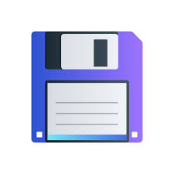



Import Job
User 1. Prepare the disks with the data that you want to transfer 2. Create a job in Azure 3. Ship the disks
Azure 4. Receive disks 5. Transfer user data to their storage account 6. Package disks 7. Ship disks back to user
Again User 8. Receive disks 9. View user data in Azure Storage

Slide 19
Export Job
User 1. Create a job in Azure 2. Ship the empty disks
Azure 3. Receive disks 4. Transfer user data from their storage account to their disks 6. Package disks 7. Ship disks back to user
Again User 8. Receive the disks with user required data

Slide 20
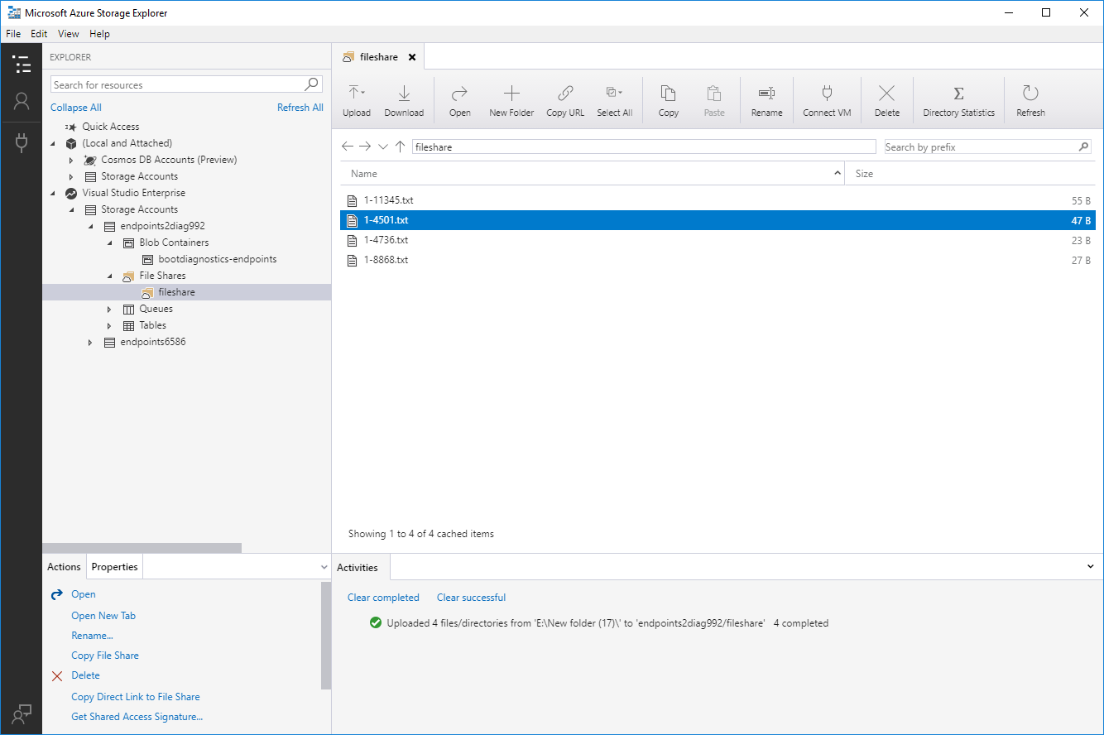
Azure Storage Explorer
The Azure Storage Explorer is an application which helps users easily access the Azure storage account through any device on any platform, (Windows, MacOS, or Linux).
Users can easily connect to their subscription and manipulate their tables, blobs, queues, and files. In addition, they can connect to, and manipulate, Azure Cosmos DB Storage and Azure Data Lake Storage.

Slide 21
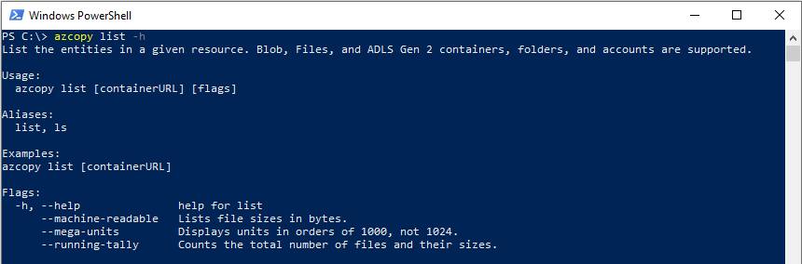
AzCopy
This is a free tool that allows users to copy and move data to and from Azure storage. Installing this command-line utility on the workstation is not required.

Slide 22
Lesson 3 – Azure Files & Azure Blob

Slide 23
Blob Storage and File Storage
Blob Storage
File Storage
Azure Blob Storage is an object storage solution for the cloud. Blob Storage allows users to store a massive amount of unstructured data. The unstructured data doesn’t need to be a specific data model.
Azure files offer fully managed file shares in the cloud that are accessible via the industry standard – SMB. Azure file shares can be mounted concurrently by cloud or on-premises deployments of Windows, Linux, and macOS. It can be cached on Windows servers with Azure File Sync for faster access.

Slide 24
When to use?
Blob Storage
File Storage
Azure Blob Storage was designed to serve specific needs. If user business use case needs to store unstructured data like audio, video, images, etc.
File Storage can be used if the users business use case needs to deal mostly with standard file extensions like *.docx, *.png and *.bak

Slide 25
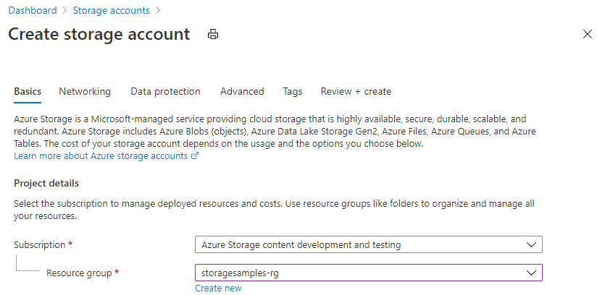
Creating an Azure File Share
STEPS
Sign into the portal
Create a storage account

Slide 26
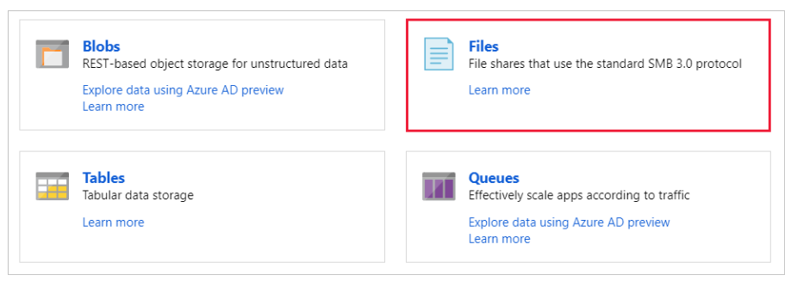
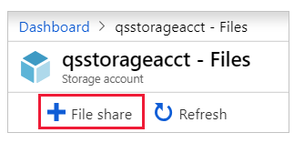
Creating an Azure File Share
STEPS
3. Create an Azure File Share and upload a file.

Slide 27
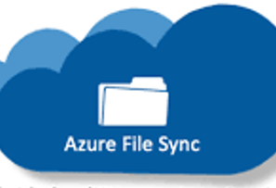
Azure File Sync Service
With Azure File Sync, user shares can be replicated on-premises or in Azure and accessed through SMB or NFS shares on Windows Server. Azure File Sync is useful for scenarios in which data needs to be accessed and modified far away from an Azure datacenter (such as in a branch office scenario). Data may be replicated between multiple Windows Server endpoints, such as between multiple branch offices.

Slide 28
Azure File Sync Service Components
FileSyncSvc.exe: The background Windows service responsible for monitoring changes on Server Endpoints and initiating sync sessions to Azure.
StorageSync.sys: The Azure File Sync file system filter, responsible for tiering cold files to Azure Files.
PowerShell Management cmdlets: PowerShell cmdlets for interacting with the Microsoft.StorageSync Azure Resource Provider.

Slide 29
Azure Blob Storage
It allows users to store large amounts of unstructured data on Microsoft’s data storage platform. In this case, blob stands for binary large object, which includes objects such as images and multimedia files.
With Azure blob storage, the files, which are known as blobs, are put in containers which function like directories. These are then linked to the storage account.

Slide 30

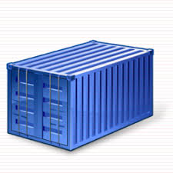


Azure Blob Storage
User Storage Account
Container
Blob
Videos Images
cats1.mov
me.jpg
you.jpg
Bob

Slide 31



Access Tiers
Hot | Cool | Archive
Optimized for storing data that is accessed frequently. | Optimized for storing data that is infrequently accessed and stored for at least 30 days. | Optimized for storing data that is rarely accessed and stored for at least 180 days.

